Slide 1
Site & Security Group Permissions In SharePoint
Giving site access to users

Slide 2
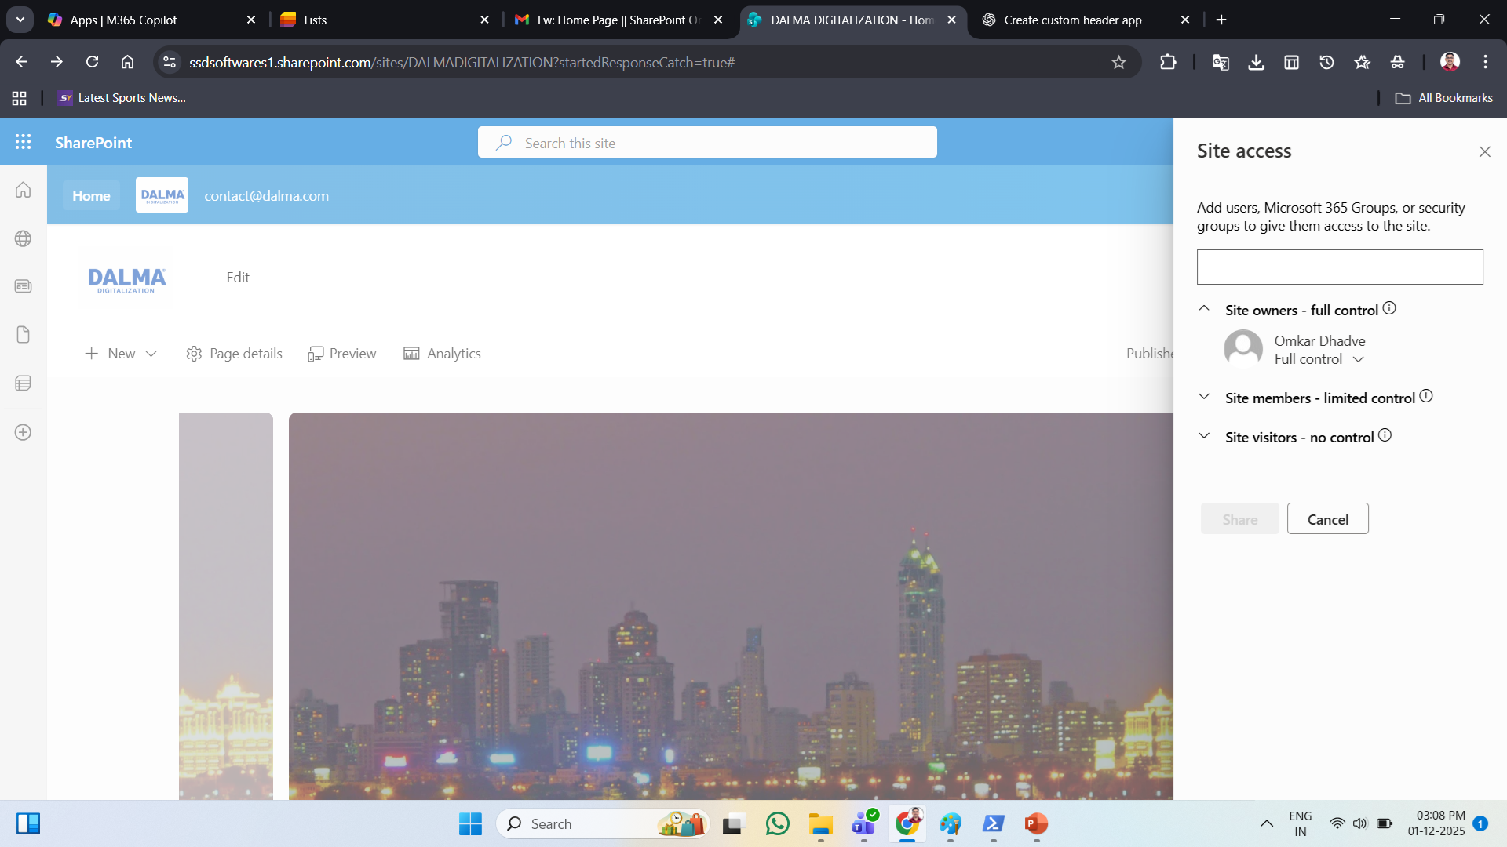
Site Permission
Site Owner – full control

Slide 3

Site members – limited control

Slide 4

Site visitors – no control

Slide 5
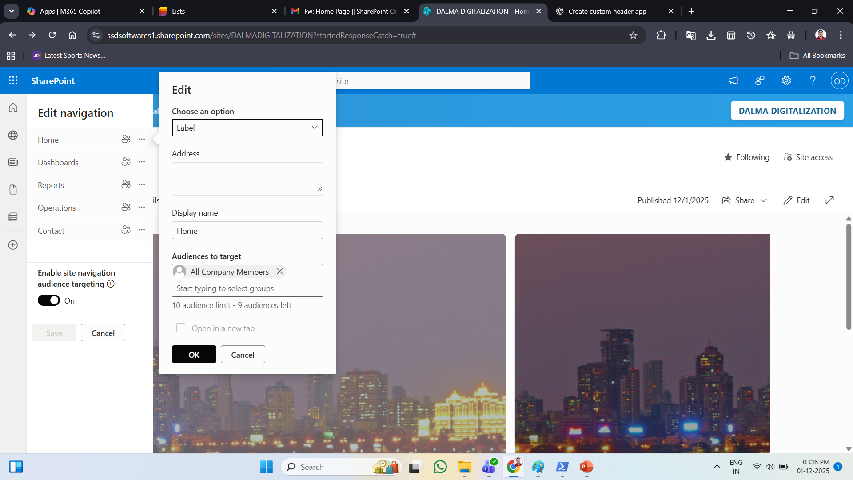
Navbar Audience Targeting – Security Groups
Home – Security Group – All Company Members

Slide 6
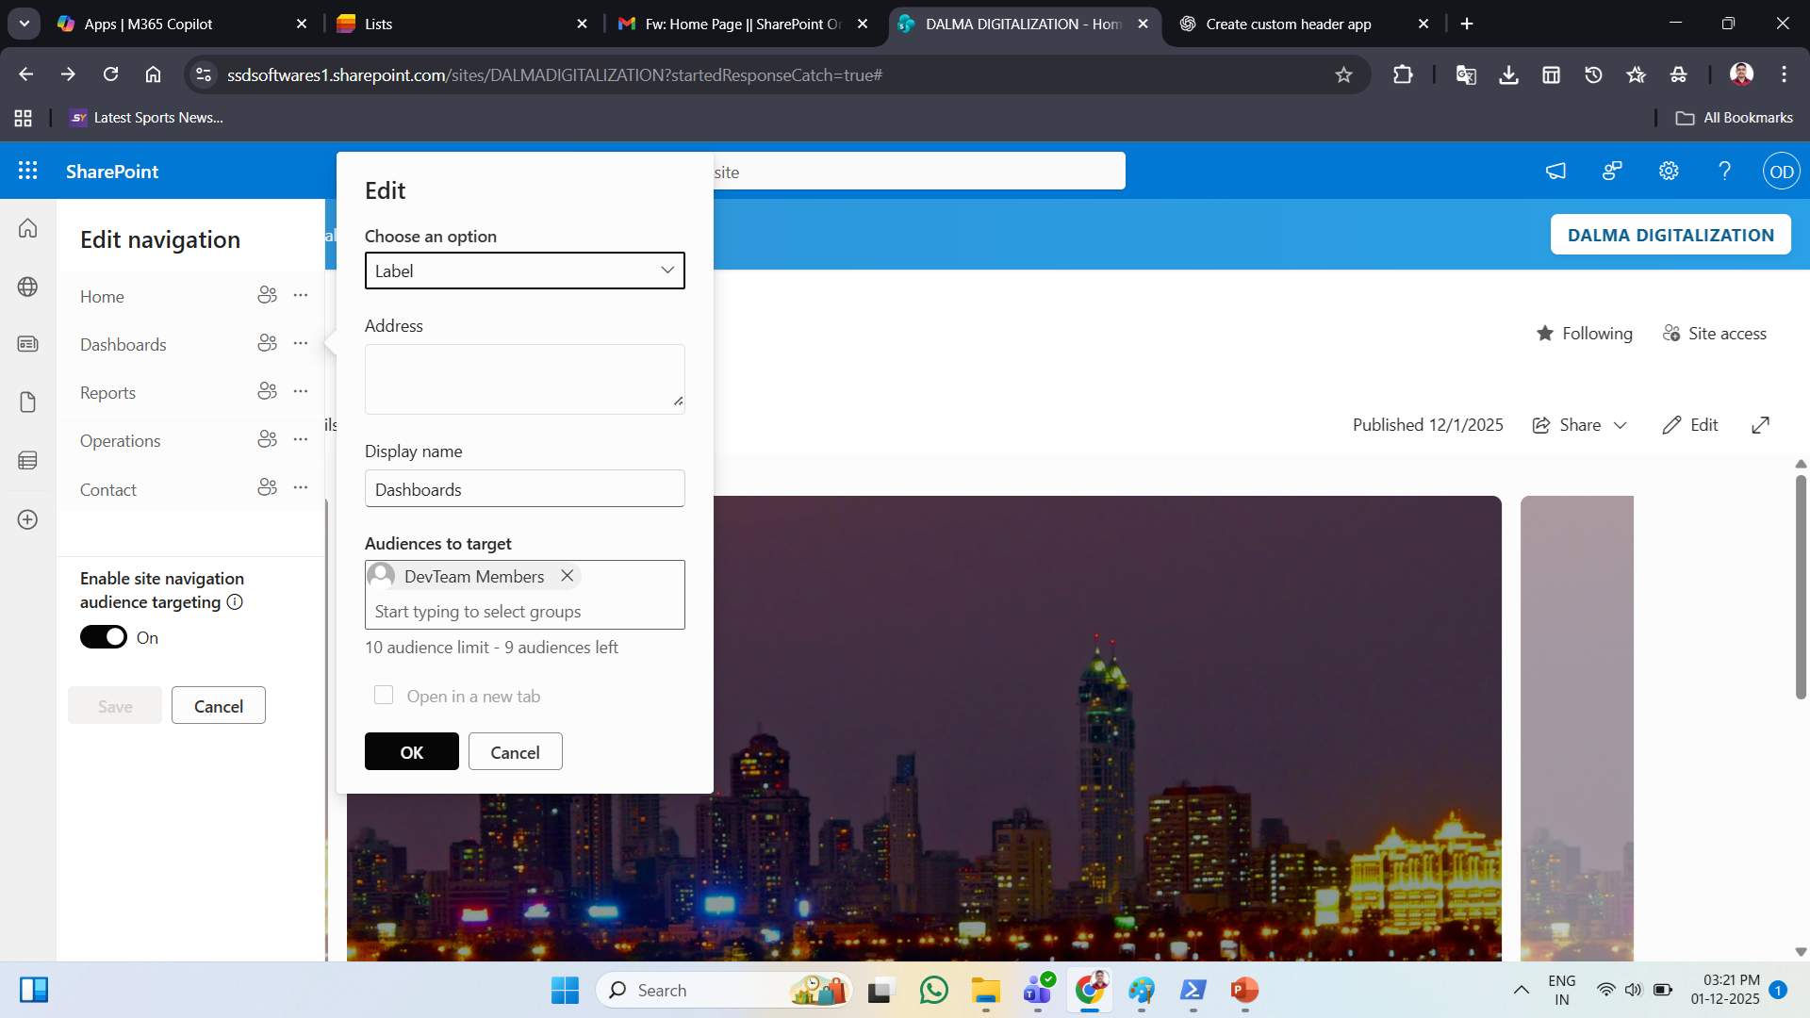
Dashboards – DevTeam Members

Slide 7
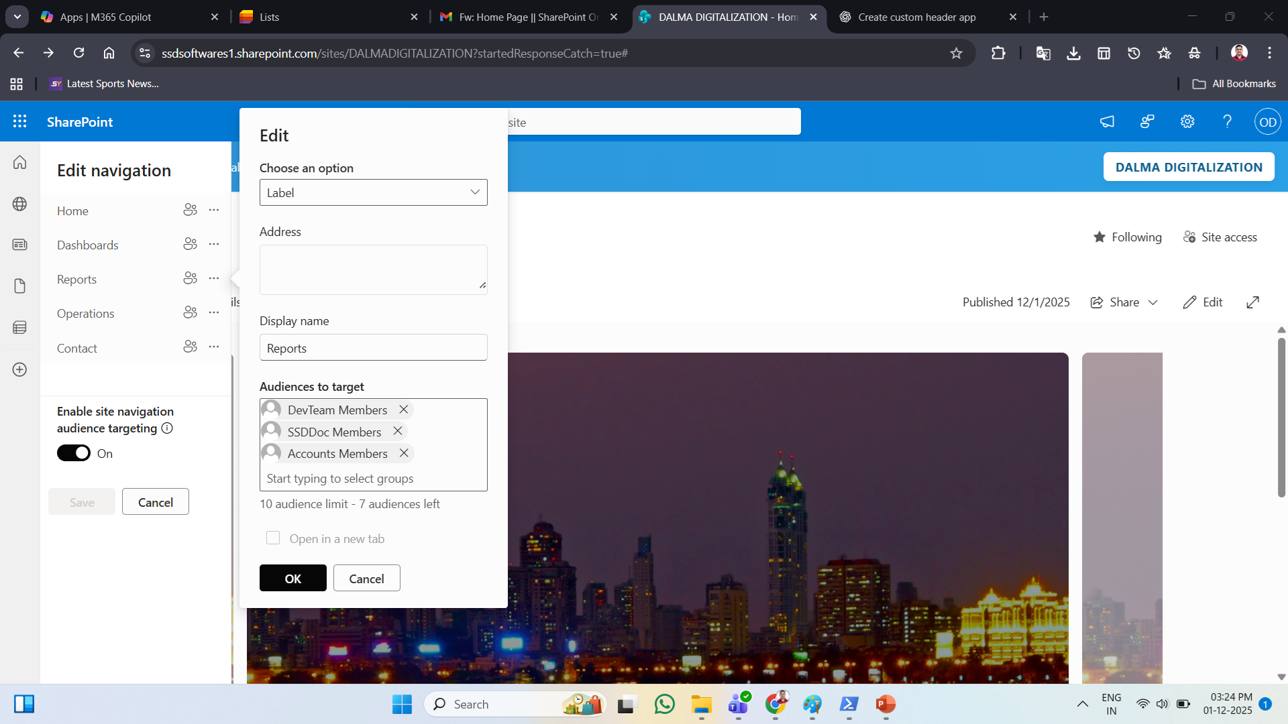
Reports – DevTeam Members, SSDDoc Members, Accounts Members

Slide 8
As per given images, We can Give Site Access to the users, & Nav items access by giving permission to Security groups which is created by Company Microsoft 365 Admin

